Slide 1
Algebra 4
Day 67

Slide 2
Bell Work
Why does an outlier impact the mean more than any other of the measures of central tendency (median/mode)?
What can we do in real life situations to avoid this impact?

Slide 3
From Last Time
Page 715 #1-3, 5-9, 11-13

Slide 4
11.7 Standard Deviation
Objective: To find and apply the standard deviation and variance of a set of values

Slide 5
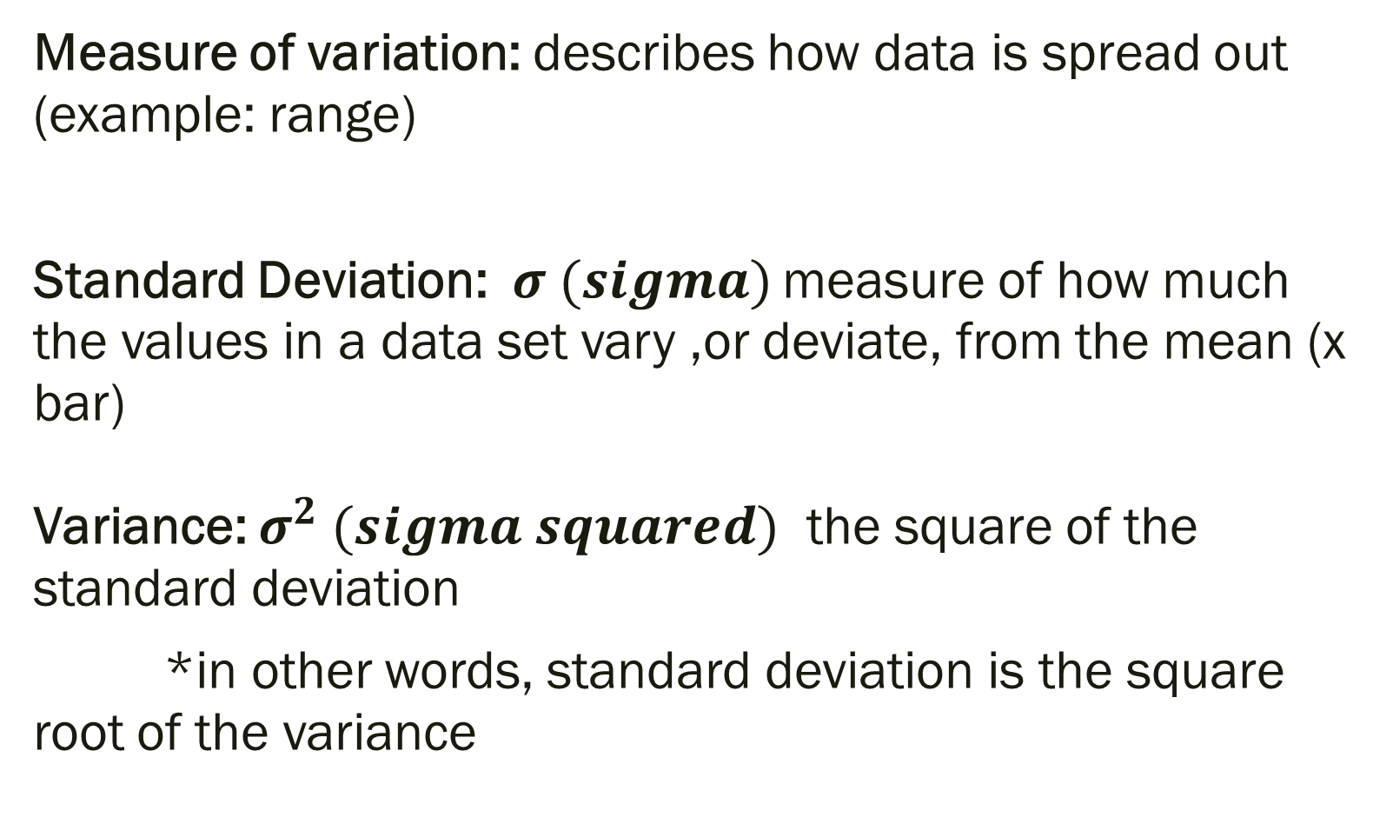
Measure of variation: describes how data is spread out (example: range)
Standard Deviation:$σ (sigma)$ measure of how much the values in a data set vary ,or deviate, from the mean (x bar) Variance: $σ^{2} (sigma squared)$ the square of the standard deviation
*in other words, standard deviation is the square root of the variance

Slide 6
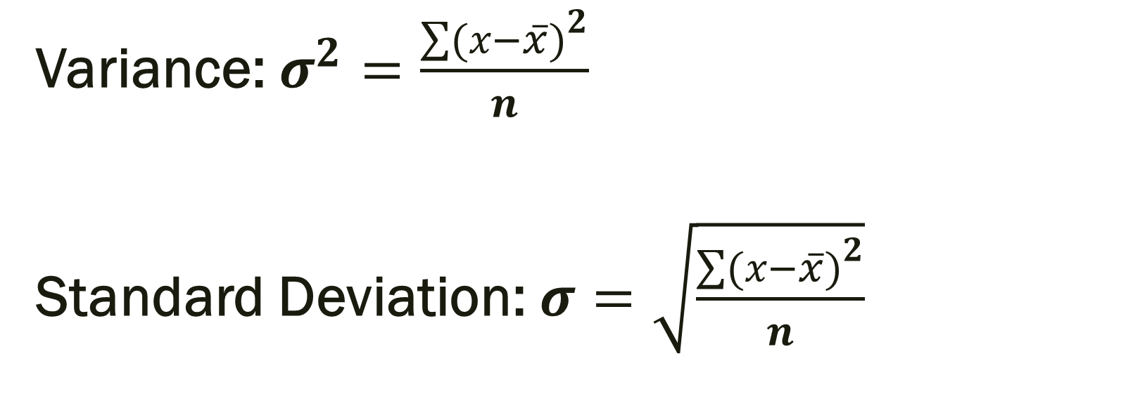
Formulas
Variance: $σ^{2}=\frac{\sum{{(x−\overline{x})}^{2}}}{n}$
Standard Deviation: $σ=\sqrt{\frac{\sum{{(x−\overline{x})}^{2}}}{n}}$

Slide 7
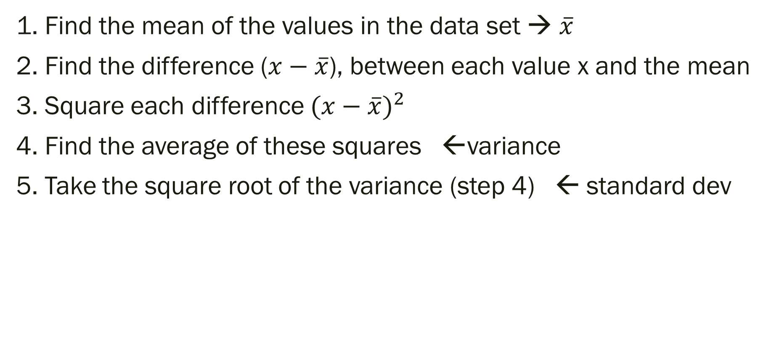
Steps to finding Variance/Standard Deviation
1. Find the mean of the values in the data set → $\overline{x}$
2. Find the difference ($x−\overline{x}$), between each value x and the mean
3. Square each difference ${(x−\overline{x})}^{2}$
4. Find the average of these squares ←variance
5. Take the square root of the variance (step 4) ← standard dev

Slide 8
Example:
What is the mean, variance and standard deviation of the following values?
8, 12, 10, 13, 9, 20

Slide 9
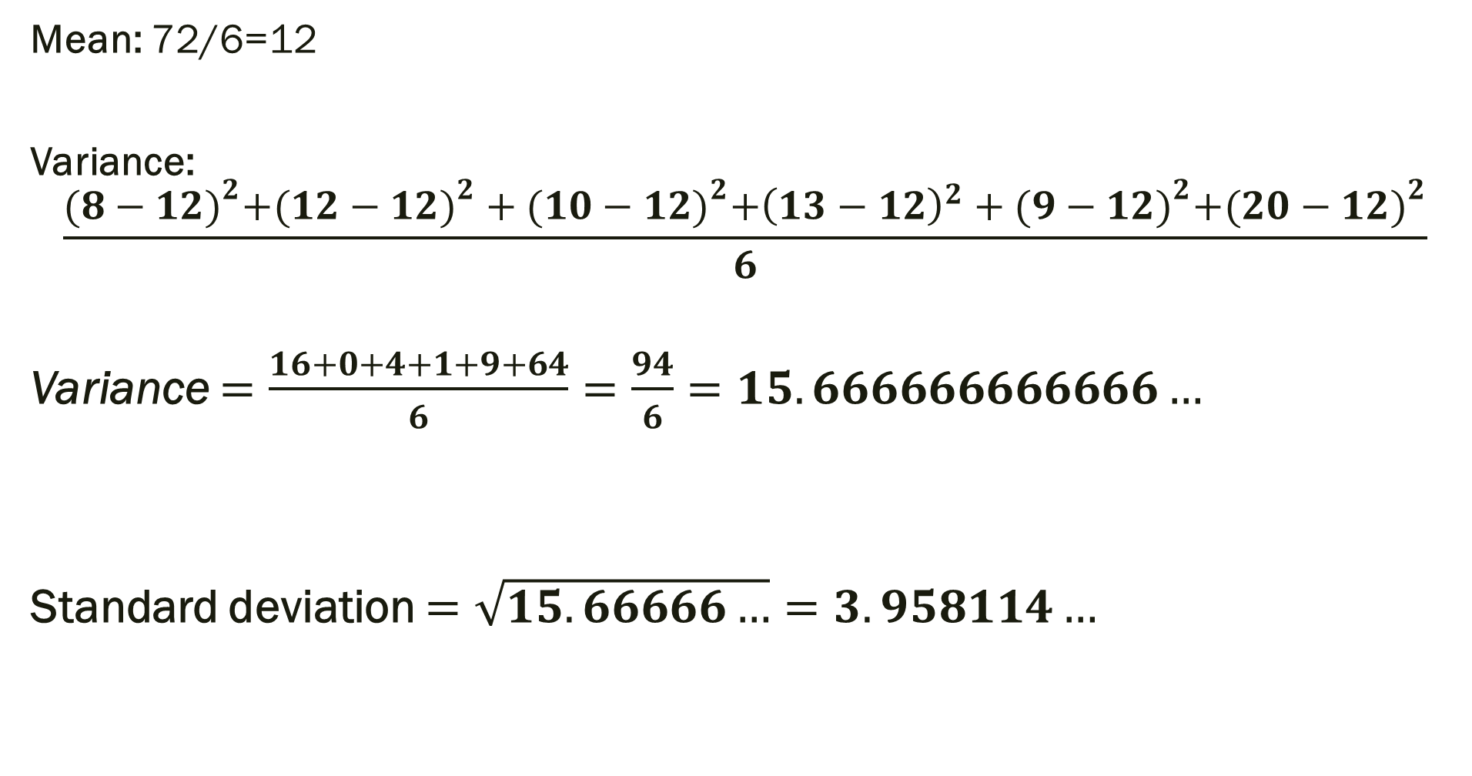
Solution
Mean: 72/6=12
Variance: $$\frac{{(8−12)}^{2}{+(12−12)}^{2}+{(10−12)}^{2}+{\left(13−12\right)}^{2}+{(9−12)}^{2}+{(20−12)}^{2}}{6}$$
Variance $=\frac{16+0+4+1+9+64}{6}=\frac{94}{6}=15.666666666666…$
Standard deviation $=\sqrt{15.66666…}=3.958114…$

Slide 10
Compare the data:
-3SD -2SD -1SD 0.486 4.084 8.042 Mean
12 +1SD +2SD +3SD
15.958 19.916 23.514

Slide 11
What does this all mean?!
We can see that the 20 is the one that is different than the rest because all other numbers are right around 1 standard deviation of the mean and the 20 is beyond the 2nd standard deviation. It is important to note that all data falls within 3 standard deviations of the mean however. We’ll explore that in 11.10 and how this all can be applied to real life situations.

Slide 12
For Next Time
Page 722 #1-5, 7-11 (odd), 21

